Slide 1
Introduction to ROS
Kaustubh Joshi
Alex Beyer

Slide 2
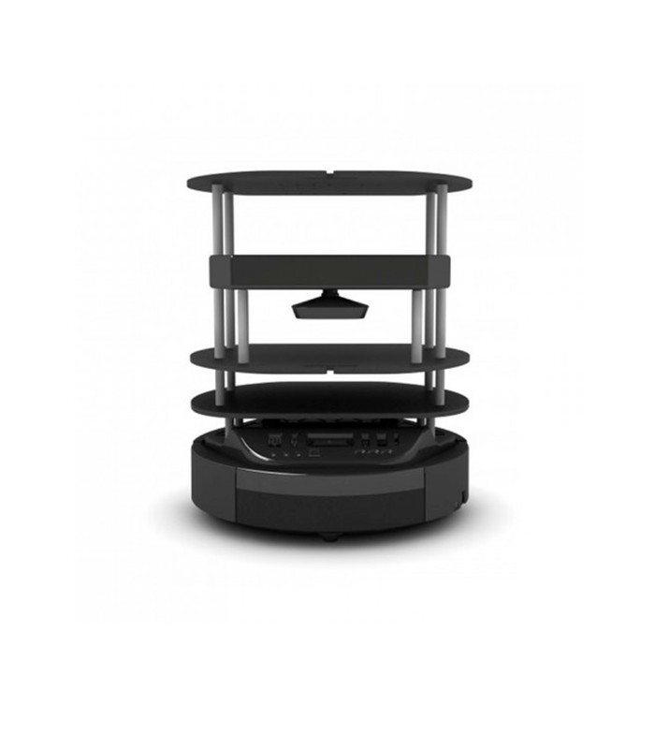


DEVELOPING A ROBOT
Turtlebot 2
Camera
PID Controller
Motors
Path Planning
SLAM
Object Tracking
Machine Learning
Data Logging
Error Analysis

Slide 3
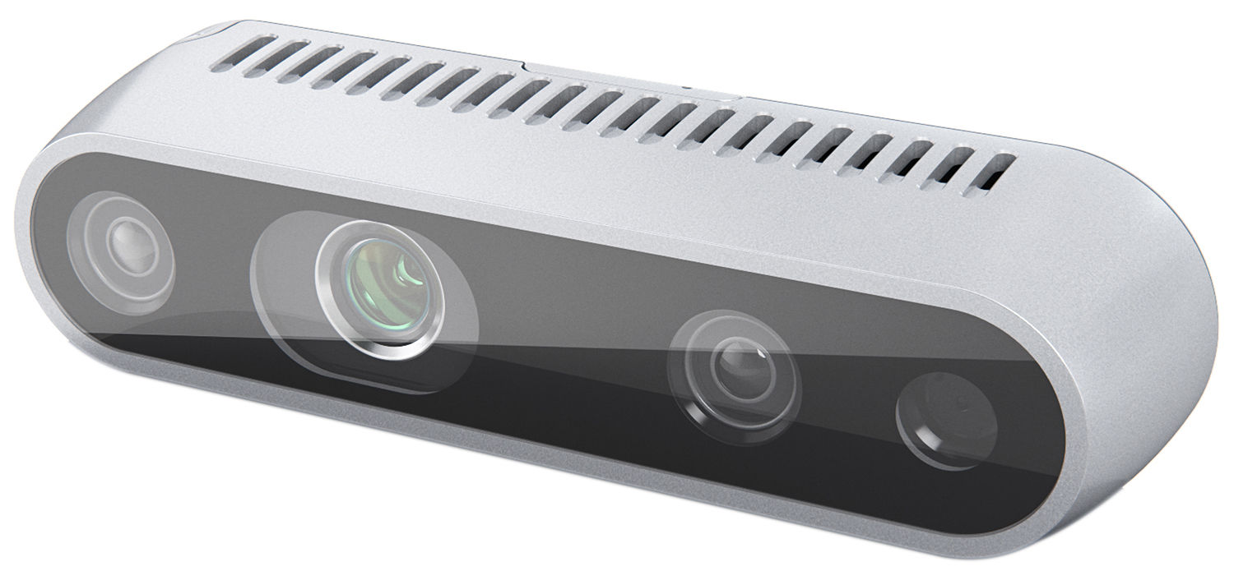

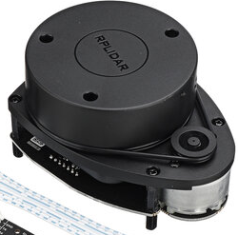
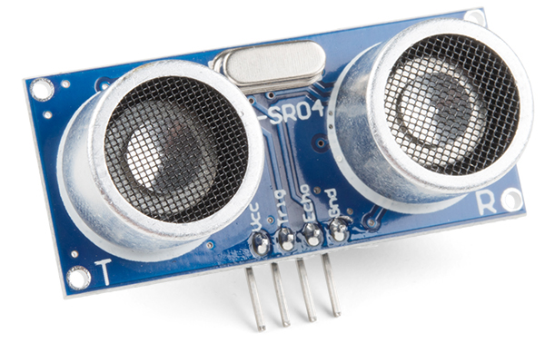
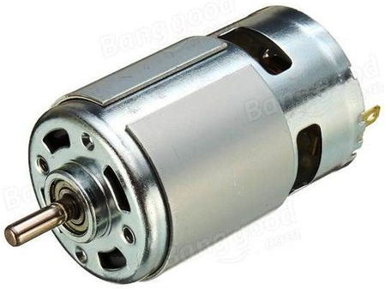
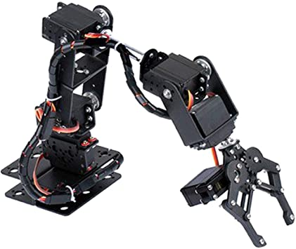
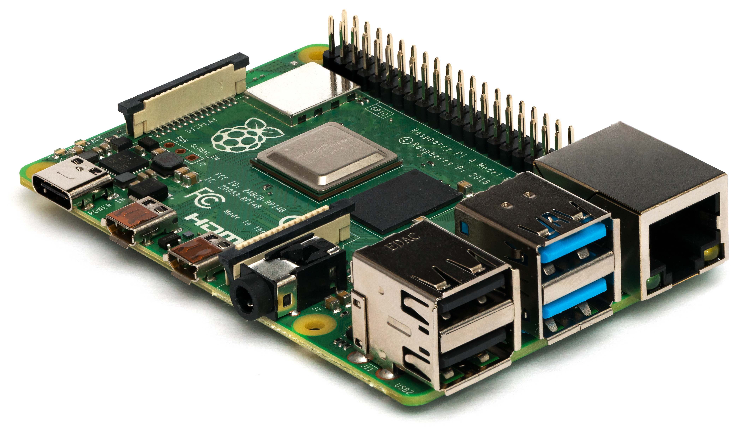
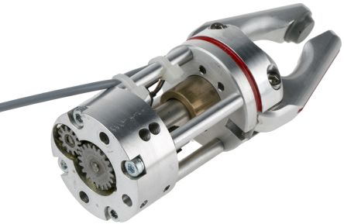
ROBOTICS DEVELOPMENT
Standard Robot Platforms
Sensors
Off the shelf robots with few sensors and mechanical components integrated
E.g. Turtlebot, Nao, Husky, UR5
Equipment for perception
E.g. Cameras, Proximity sensors, LiDAR, etc.
Components in Robot Development
Electronics and Computing
Mechanical Equipment
Electronic components and computing and control hardware
E.g. Motors, Encoders, Arduino, Raspberry Pi
Additional mechanical hardware for task based requirements
E.g. Manipulators, Grippers, etc.
Kaustubh Joshi

Slide 4
ROADBLOCKS IN ROBOT DEVELOPMENT
Which modules are required in developing a robot?
Communication
Visualization
Control
Simulation
Exploration
Actuator
Perception
Data Logging
Planning
Before ROS:
If a new robot is to be made, all the modules will be required to developed again and needs to be done from scratch
If any sensor needs to exchanged between two robots, entire code interface needs to be changed
For adding a new functionality/module, entire code and framework needs to be changed
So, what does ROS do?

Slide 5
WHAT IS ROS
Robot Operating System(ROS) is an open-source meta-operating system for robotics
How does it benefit robot development?
It provides numerous basic algorithms for robotics for a variety of robot platforms (e.g. Turtlebot, UR5, etc.), sensors and electronic equipment
Follows a modular approach which helps in using and building up on existing software and hardware according to user requirements
Enables parallelization and networking, allowing processes to run on multiple systems (and robots)
Independent of programming language (Python, C++, Java, etc.)
Ready-to-use modules help in testing robots immediately
In-built simulation (Gazebo) and visualization (RViz) environments – and now NVIDIA IssacSim too

Slide 6

ROS – AN OVERVIEW
What is ROS exactly? A middleware, a framework or an operating system?
=
+
+
+
Plumbing
Tools
Capabilities
Ecosystem
Provides the publish-subscribe infrastructure designed to support the quick and easy construction of distributed computing systems
Provides an extensive set of tools for configuring, starting, introspecting, debugging, visualizing, logging, testing, and stopping distributed computing systems
Provides a broad collection of libraries that implement useful robot functionality, with a focus on mobility, manipulation, and perception
Supported and improved by a large community, with a strong focus on integration and documentation
What is the difference between ROS and an operating system?
ROS sits on top of an OS and helps in running processes on a robot as a computer would.
It does not natively provide the services which a traditional OS does.
e.g. Memory Management, Web Browsers, Window Managers, etc.
Source: https://answers.ros.org/question/12230/what-is-ros-exactly-middleware-framework-operating-system/

Slide 7
CONCEPTS IN ROS
LEVELS OF CONCEPTS
NAMES
COMPUTATION GRAPH
FILESYSTEM
COMMUNITY
Graph Resource Names
Package Resource Names
Nodes
Topics
Messages
Services
Master
Parameter Server
Bags
Packages
Metapackages
Package Manifests
Message Types
Service Types
Distributions
Repositories
ROS Wiki and Forums

Slide 8
CONCEPTS IN ROS
LEVELS OF CONCEPTS
NAMES
COMPUTATION GRAPH
FILESYSTEM
COMMUNITY
Graph Resource Names
Package Resource Names
Nodes
Topics
Messages
Services
Master/Discovery
Parameter Server
Bags
Packages
Metapackages
Package Manifests
Message Types
Service Types
Distributions
Repositories
ROS Wiki and Forums

Slide 9



ROS NODE
FEATURES
EXAMPLE
Process that performs computation
e.g. Sensor drivers, motor drivers, etc.
Nodes communicate with each other by publishing or subscribing to Topics
Nodes can offer or call a Service by sending a Message
Written using ROS client libraries roscpp(C++) and rospy(Python)
Command-line tool to display information:
rosnode <argument>
ros2 node <argument>
Have a Graph Resource Name and type which is Package Resource Name
Hardware
Node
Package
Robot
Remote PC
Serial Comm
Visualization (RViz)
Control
State/Odometry
Markers
Path Correction
Motion Planning
Object Tracking
Camera Nodes
RGB-D Camera

Slide 10





ROS TOPIC
FEATURES
EXAMPLE
Named buses over which nodes stream messages
Nodes communicate with each other by publishing or subscribing to Topics unidirectionally
Command-line tool to display information:
rostopic <argument>
ros2 topic <argument>
Publish/Subscribe Model: Many-to-many one way transport
A node can publish and subscribe over multiple topics
Hardware
Node
Package
Topic
Robot
Remote PC
Serial Comm
Visualization (RViz)
/velocity
/pose
Control
State/Odometry
Markers
Source: Robotics Backend
Path Correction
Motion Planning
98.3
Health data
/path
/depth
/rgb
Object Tracking
Camera Nodes
95.0
Location
RGB-D Camera
Topic
Topic

Slide 11

ROS SERVICES
FEATURES
EXAMPLE
Pair of messages between nodes; one for request and other for reply
Request/Reply Model: one-to-one synchronous
Used for computations and quick actions
Command-line tool to display information:
rosservice ros2 service <argument>
Used when a client-server architecture is required
Hardware
Node
Package
Topic
Service
Robot
Remote PC
/battery
/settings
Serial Comm
Visualization (RViz)
/velocity
/pose
Control
State/Odometry
Markers
Source: Robotics Backend
Path Correction
Motion Planning
/path
/depth
/rgb
Object Tracking
Camera Nodes
Weather Service: http://...
/power
/settings
Weather
Location
Location
Weather
Weather
Location
RGB-D Camera

Slide 12
ROS MESSAGE
FEATURES
EXAMPLE
Type of data structure to communicate between nodes
Can include arbitrarily nested structures and arrays
Can exchange a request or response as a Service call
Command-line tool to display information:
rosmsg <argument>
ros2 msg <argument>
Hardware
Node
Package
Topic
Service
Robot
Remote PC
/battery
/settings
Serial Comm
Visualization (RViz)
/velocity
/pose
Control
State/Odometry
Markers
Path Correction
Motion Planning
/path
/depth
/rgb
Object Tracking
Camera Nodes
/power
/settings
/velocity -> geometry_msgs/Twist is a message to express velocity commands:
Vector3 linear; (Vector3: {x,y,z})
Vector3 angular
RGB-D Camera

Slide 13
ROS1 MASTER / ROS2 DISCOVERY
FEATURES
EXAMPLE
Enables connection and transmission of messages for all the nodes in the system
Tracks publishers and subscribers to all topics and services
Command-line tool to initialise:
roscore
No initialization required in ROS2 if a node is active
Hardware
Node
Package
Topic
Service
Master/Discovery
Robot
Remote PC
/battery
/settings
Serial Comm
Visualization (RViz)
Control
State/Odometry
Markers
Master/Discovery
Path Correction
Motion Planning
Registration
Registration
/path
/depth
/rgb
Object Tracking
Camera Nodes
Node 1
Messages
Node 2
Messages
Node 3
/power
/settings
Messages
RGB-D Camera

Slide 14
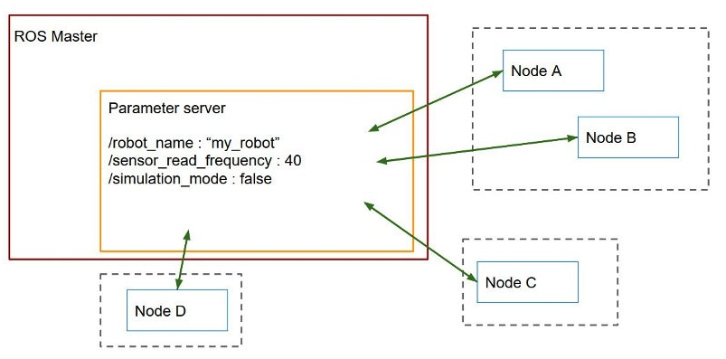
PARAMETER SERVER
FEATURES
EXAMPLE
Shared, multi-variate dictionary that is accessible through network APIs
Runs inside ROS Master
Nodes use this server to store and retrieve parameters at runtime
Used for static, non-binary data such as configuration parameters
Hardware
Node
Package
Topic
Service
Master
Parameter Server
Robot
Remote PC
/battery
/settings
Serial Comm
Visualization (RViz)
Control
State/Odometry
Markers
Path Correction
Motion Planning
/path
/robot_model=“my_robot”
/max_speed=0.5
/slam_node=True
Object Tracking
/depth
/rgb
Camera Nodes
/power
/settings
RGB-D Camera
Source: Robotics Backend

Slide 15
ROS BAGS
FEATURES
EXAMPLE
Used for storing ROS Message data
Bags subscribe to one or more ROS topics and store the serialized message data in a “bag”
ROS1 - .bag file
ROS2 - .db3 file
Can playback data as well
Also provides the Parameter Server
Command-line tools:
rosbag
ros2 bag
Hardware
Node
Package
Topic
Service
Master
Parameter Server
Bag File
Robot
Remote PC
/battery
/settings
Serial Comm
Visualization (RViz)
Control
State/Odometry
Markers
Path Correction
Motion Planning
/path
/robot_model=“my_robot”
/max_speed=0.5
/slam_node=True
Object Tracking
/depth
/rgb
Camera Nodes
/power
/settings
/battery
/path
/objects
RGB-D Camera
/camera
/odom
/ground

Slide 16
CONCEPTS IN ROS
LEVELS OF CONCEPTS
NAMES
COMPUTATION GRAPH
FILESYSTEM
COMMUNITY
Graph Resource Names
Package Resource Names
Nodes
Topics
Messages
Services
Master
Parameter Server
Bags
Packages
Metapackages
Package Manifests
Message Types
Service Types
Distributions
Repositories
ROS Wiki and Forums

Slide 17
ROS FILESYSTEM
FEATURES
EXAMPLE
ROS software is organized in packages
Contains nodes, configuration files, datasets, etc.
Goal is to provide useful functionality in an easy-to-consume manner and reusability
Metapackages: Specialized packages used as a virtual package. It references one or more related packages together
Package Manifest: Mandatory XML file in a package which defines the properties of the package
Messages Description Files: .msg files which describe the data values that ROS nodes publish
Service Description Files: .srv files to enable request/response communication between ROS nodes
METAPACKAGE
PACKAGE 1
MESSAGES
SERVICES
PACKAGE MANIFEST
SCRIPTS
LAUNCH FILES
LOGS
MISC
PACKAGE 2
MESSAGES
SERVICES
PACKAGE MANIFEST
SCRIPTS
LAUNCH FILES
LOGS
MISC

Slide 18
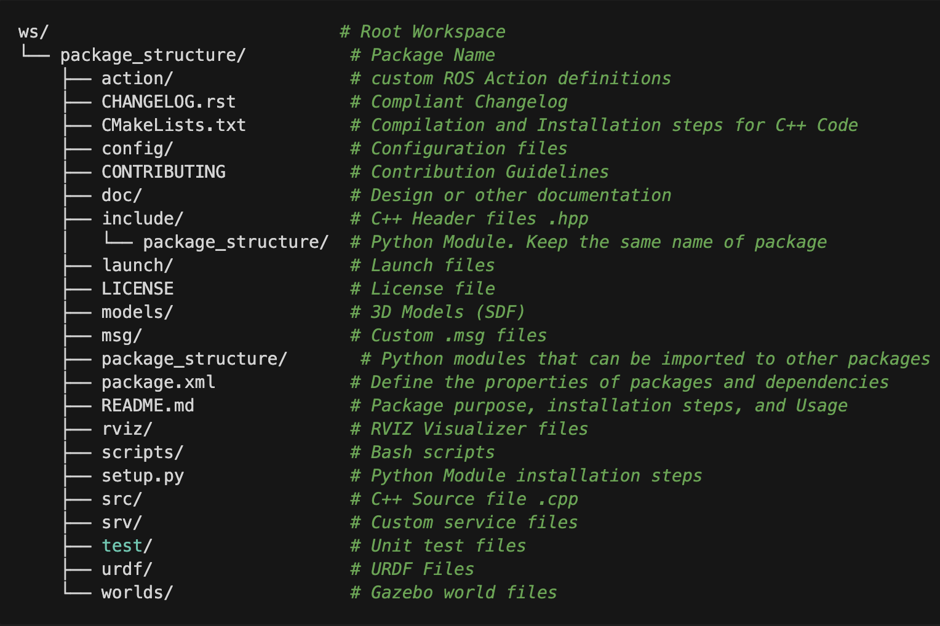
ROS PACKAGE
FEATURES
EXAMPLE
ROS packages is contained in a workspace
A package contains all codes and resources for a project
Packages created using colcon build
Creating a package tutorial: [Link]
Source Space | Source code of the package is stored here. Can contain one or more packages
Build Space | This is where the package is compiled. Cache files and intermediate files are stored here
Devel Space | Built targets are placed here before being installed, for temporary usage
Install Space | Targets are installed here once they are built and is the final product
Ref: Medium Blog

Slide 19
CONCEPTS IN ROS
LEVELS OF CONCEPTS
NAMES
COMPUTATION GRAPH
FILESYSTEM
COMMUNITY
Graph Resource Names
Package Resource Names
Nodes
Topics
Messages
Services
Master
Parameter Server
Bags
Packages
Metapackages
Package Manifests
Message Types
Service Types
Distributions
Repositories
ROS Wiki and Forums

Slide 20
ROS COMMUNITY
Distribution: A version of ROS packages.
Repositories: Software developed by independent institutions or individuals. Generally hosted on GitHub
ROS Wiki: Documentation and tutorials for ROS and suitable packages
ROS Forum: Website for Q&A related to ROS
Others include a ROS Blog for news, ROS Mailing List for new updates, a Bug Ticketing System
Linux Distribution | ROS 1 Distrbution (LTS) | ROS 2 Distribution (LTS)
Ubuntu 16.04 (Xenial Xerus) | Kinetic | N/A
Ubuntu 18.04 (Bionic Beaver) | Melodic | Dashing
Ubuntu 20.04 (Focal Fossa) | Noetic | Foxy, Galactic
Ubuntu 22.04 (Jammy Jellyfish) | No longer supported | Humble, Iron
Ubuntu 24.04 (Noble Numbat) | No longer supported | Jazzy

Slide 21
CONCEPTS IN ROS
LEVELS OF CONCEPTS
NAMES
COMPUTATION GRAPH
FILESYSTEM
COMMUNITY
Graph Resource Names
Package Resource Names
Nodes
Topics
Messages
Services
Master
Parameter Server
Bags
Packages
Metapackages
Package Manifests
Message Types
Service Types
Distributions
Repositories
ROS Wiki and Forums

Slide 22
NAMES
Graph Resource Names
Provide a hierarchical naming structure for all resources in ROS Computation Graph (nodes, topics, messages, etc.)
e.g. /slam
/turtlebot_teleop
/map
Package Resource Names
Used for referring to the ROS Filesystem level concepts (message types, service types, etc. )
E.g. std_msgs/String is an abbreviation for /<path>/std_msgs/msg.String.msg

Slide 23
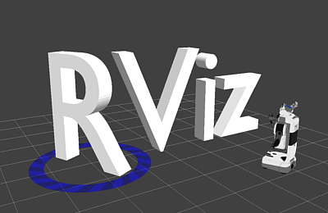

ROS TOOLS AND COMMANDS
GAZEBO
RViz
A 3D simulator for robotics applications
gazebo
Models can be imported and sensor plugins can be incorporated into the simulation environment in SDF or URDF format
Environmental simulations can also be carried out for gravity, wind speeds, friction etc.
Tutorials and Documentation: [Gazebo]
3D Visualization environment for ROS to let us know what is the robot thinking, seeing and doing
ros2 run rviz rviz
Different topics and messages can be visualized in the form seen or perceived by the robot

Slide 24
ROS TOOLS AND COMMANDS
COMMANDS
COMMANDS
Starting a node:
ros2 run <package_name> <node_name>
List of initialized nodes:
ros2 node list
List of available topics:
ros2 topic list
Get all messages published on a topic:
ros2 topic echo <topic_name>
Publishing messages through terminal line: ros2 topic pub -r <rate-in-hz> <topic_name> <message_type> <message_content>
System Visualization of Topics, Nodes, etc:
ros2 run rqt_graph rqt_graph
Live plot of data published on topics:
ros2 run rqt_plot rqt_plot
Console to display logging data
ros2 run rqt_console rqt_console
ros2 run rqt_logger_level rqt_logger_level
Start multiple nodes in sequence with required parameters:
ros2 launch <package_name> <launch_file>
Recording data:
ros2 bag record –a (All topics)
ros2 bag record –O subset <topic> (Subset)

Slide 25
ROS INSTALLATION AND SETUP
Choose an Ubuntu distribution and corresponding ROS distribution to install
Ubuntu installation guide for Windows: [Ubuntu Official] [Third-Party Article]
Ubuntu installation guide for MacOS: [Ubuntu Official] [Third-Party Article]
ROS Installation guide: [ROS 1] [ROS 2 - Choose Distribution]
Source the ROS installation
source /opt/ros/<distro>/setup.bash
Download the TurtleSim and Gazebo packages
sudo apt install ros-<distro>-turtlesim*
sudo apt install ros-<distro>-gazebo-*

Slide 26
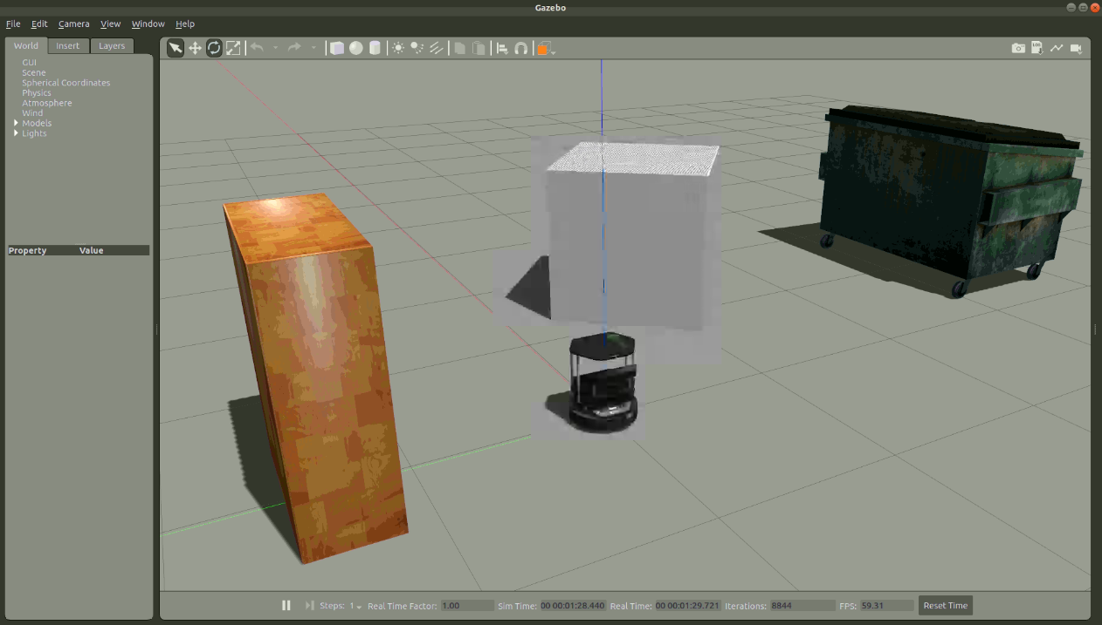
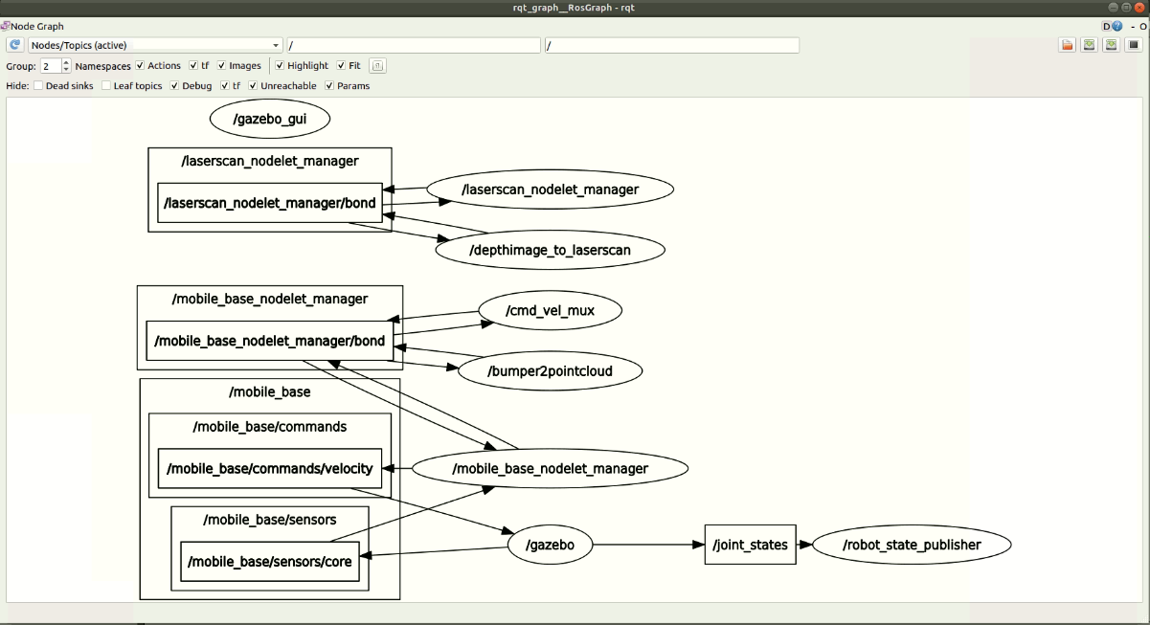
TURTLEBOT DEMO AND TUTORIAL (SIMULATION)
SIMULATION WORLD
EXPLAINATION
Terminal 1: Launch a Turtlebot in Gazebo
roslaunch turtlebot_gazebo turtlebot_world.launch
roslaunch turtlebot_gazebo turtlebot_world.launch
The launch file initializes the ROS Master and other nodes of Gazebo, Camera, Kobuki Base, etc.
Check the list of nodes and topics initialized
ROS package
Launch file in package

Slide 27
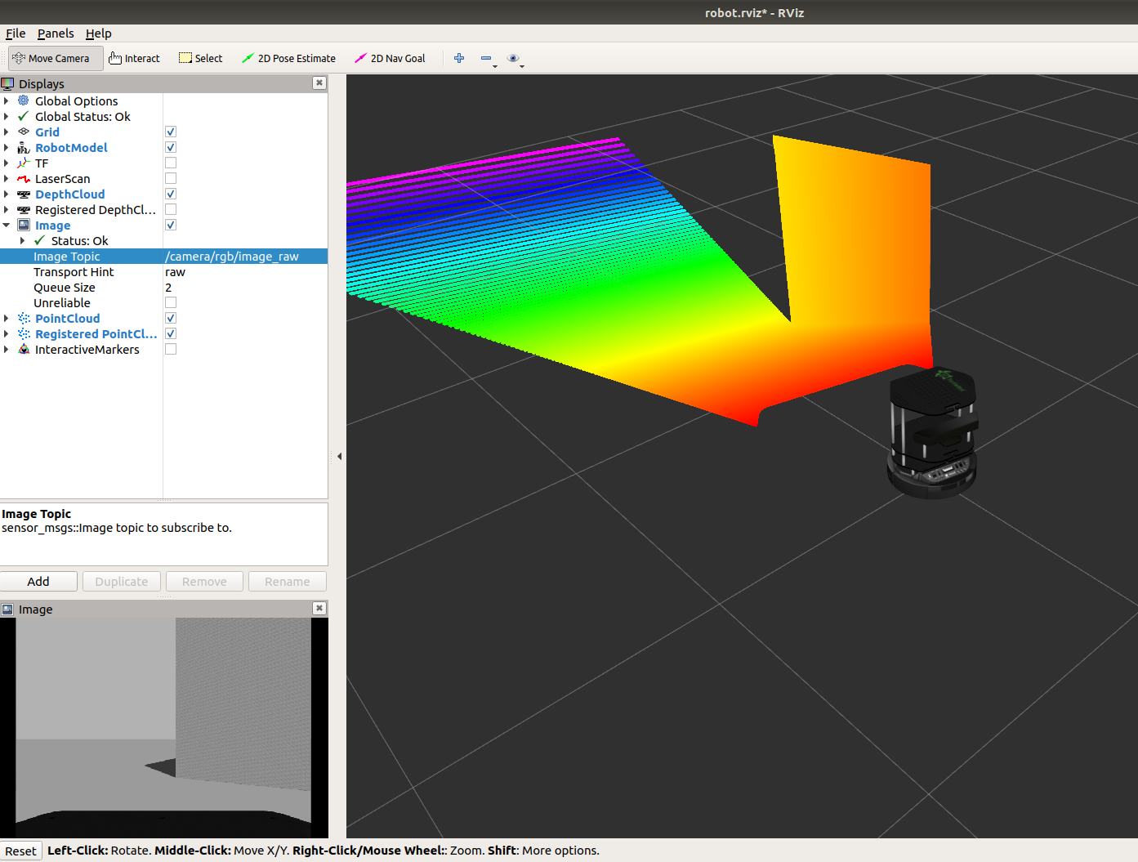
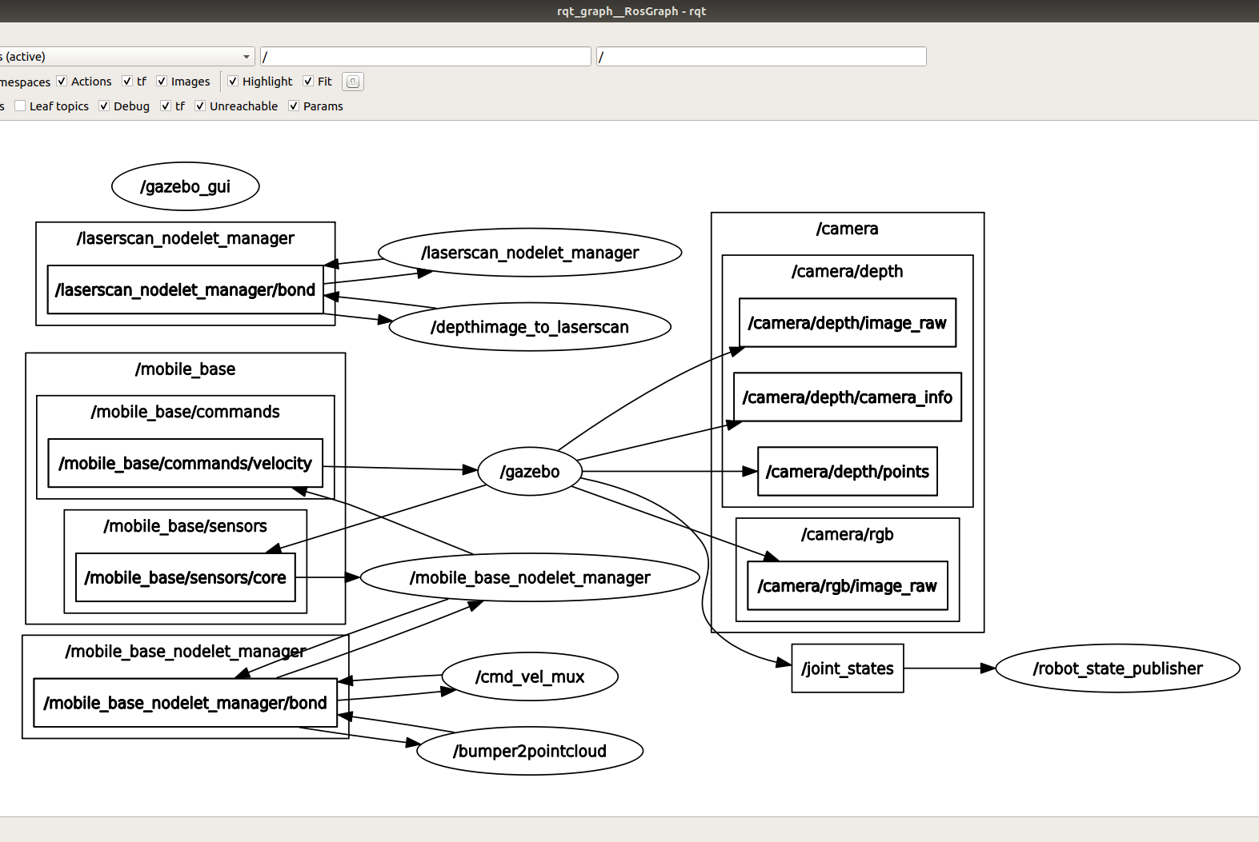
TURTLEBOT DEMO AND TUTORIAL (SIMULATION)
VISUALIZATION
EXPLAINATION
Terminal 2: Open RViz
roslaunch turtlebot_rviz_launchers view_robot.launch
The launch command opens up RViz with a model of Turtlebot
Checking Depth Cloud and Image topics displays the point cloud data and image feed of camera respectively

Slide 28
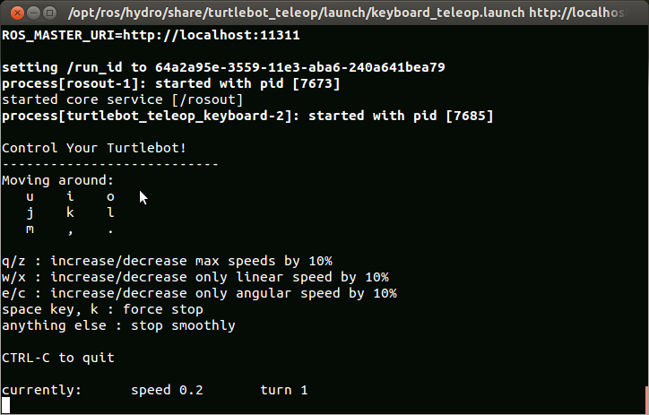
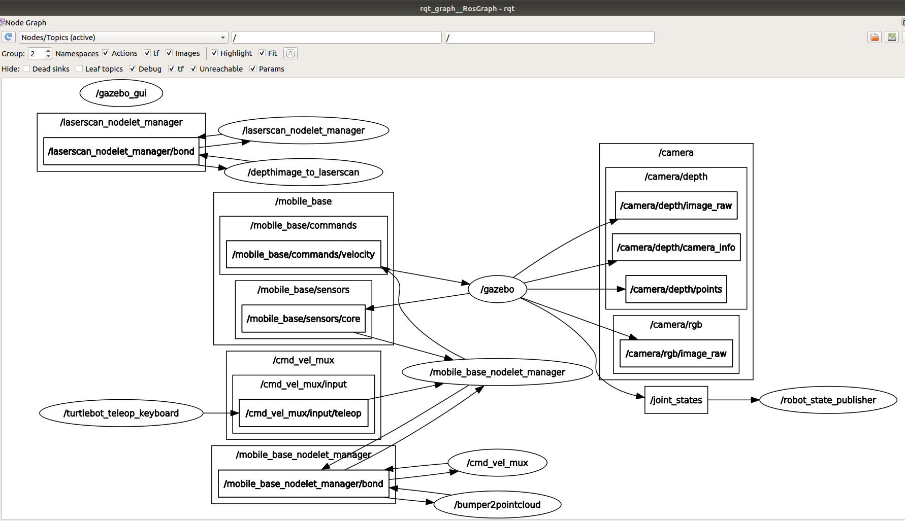
TURTLEBOT DEMO AND TUTORIAL (SIMULATION)
MANUAL CONTROL
EXPLAINATION
Terminal 3: Manual control using keyboard
roslaunch turtlebot_teleop keyboard_teleop.launch
OR
Terminal 3: Manual control using markers in RViz
roslaunch turtlebot_interactive_markers interactive_markers.launch
For tutorials on editing the simulation world: [Link]

Slide 29
TURTLEBOT DEMO AND TUTORIAL (SIMULATION)
PATH FOLLOWING AND SPEED CONTROL
CODE EXPLAINATION
# python client library
# Twist is datatype for velocity
# Create a node
# Print message in log
# stop the process when Ctrl + C
# topic to publish might change when robot changes
# Rate of publishing in Hz
# linear speed in x direction is 0.2 m/s
# angular velocity about z axis is 0 rad/s
# while Ctrl + C is not pressed..
# publish the velocity speed
# wait for 0.1 sec and publish again
# display message if Ctrl + C
# default Twist has 0 values for velocity
# to ensure robot receives command
Close all terminals
Terminal 1: Launch an empty Gazebo world
roslaunch turtlebot_gazebo empty_world.launch
Write a Python script for Turtlebot to go forward in a straight line
Source: [https://github.com/markwsilliman/turtlebot/blob/master/goforward.py]
Terminal 2: Execute the Python script
python /<path>/goforward.py
Modify the code to follow a certain path and speed as per requirement of user
import rospy
from geometry_msgs.msg import Twist
class GoForward():
def __init__(self):
rospy.init_node('GoForward', anonymous=False)
rospy.loginfo("To stop TurtleBot CTRL + C")
rospy.on_shutdown(self.shutdown)
self.cmd_vel = rospy.Publisher('cmd_vel_mux/input/navi', Twist, queue_size=10)
r = rospy.Rate(10);
move_cmd = Twist()
move_cmd.linear.x = 0.2
move_cmd.angular.z = 0
while not rospy.is_shutdown():
self.cmd_vel.publish(move_cmd)
r.sleep()
def shutdown(self):
rospy.loginfo("Stop TurtleBot")
self.cmd_vel.publish(Twist())
rospy.sleep(1)
if __name__ == '__main__':
try:
GoForward()
except:
rospy.loginfo("GoForward node terminated.")

Slide 30
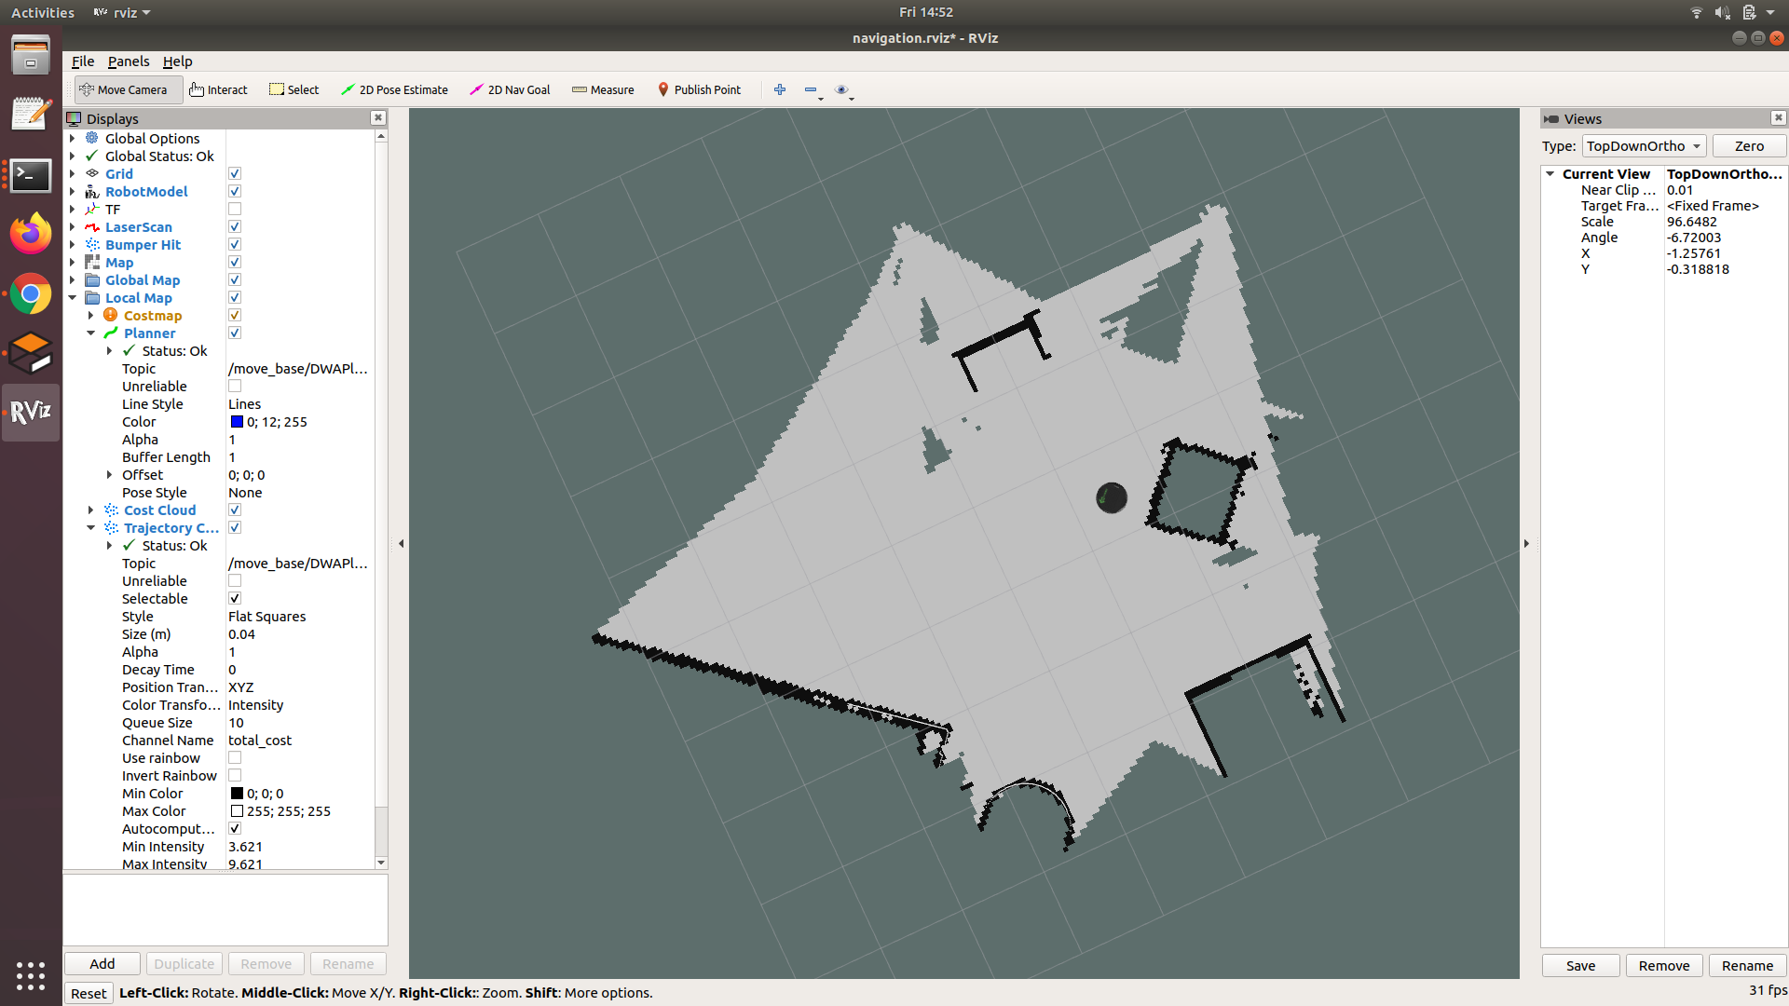
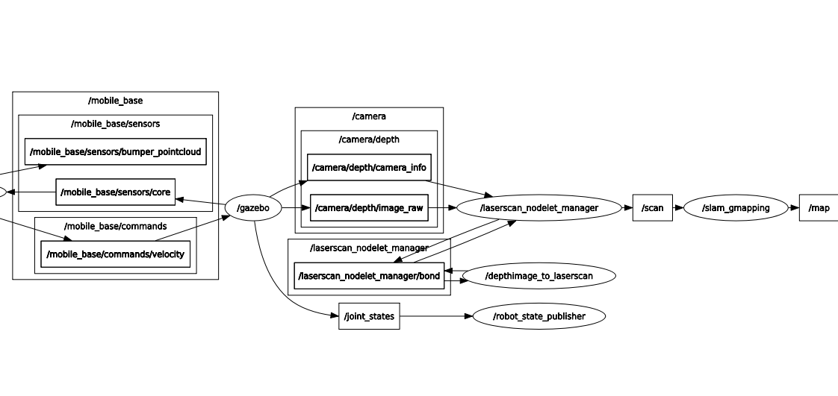
TURTLEBOT DEMO AND TUTORIAL (SIMULATION)
OBSTACLE AVOIDANCE
EXAMPLE
To go around an area and avoid obstacles, a robot needs a map and its position in the map (ie. SLAM)
STEP 1 - Create a map:
Terminal 1: Launch a Gazebo world
roslaunch turtlebot_gazebo turtlebot_world.launch
Terminal 2: Start the SLAM node (gmapping)
roslaunch turtlebot_gazebo gmapping_demo.launch
Terminal 3: Open RViz to visualise the process
roslaunch turtlebot_rviz_launchers view_navigation.launch
Terminal 4: Teleoperate the robot and carry out SLAM
roslaunch turtlebot_teleop keyboard_teleop.launch
Terminal 5: After mapping is done, save map
rosrun map_server map_saver -f /<path>/<map_name>

Slide 31
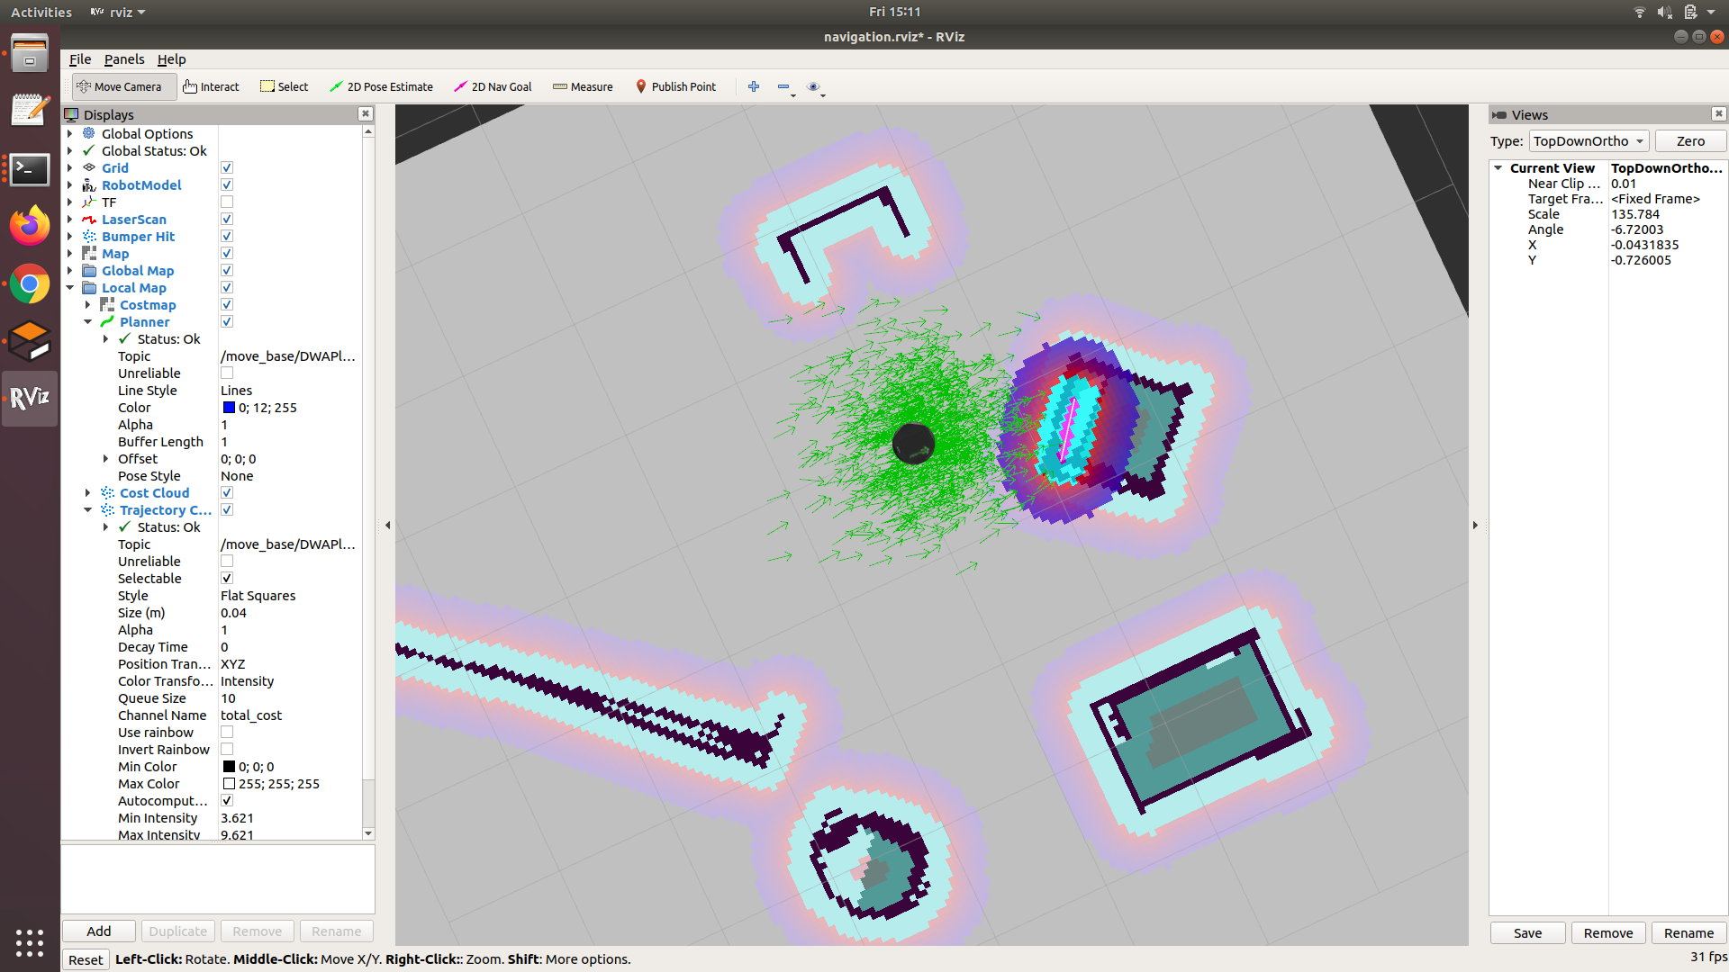
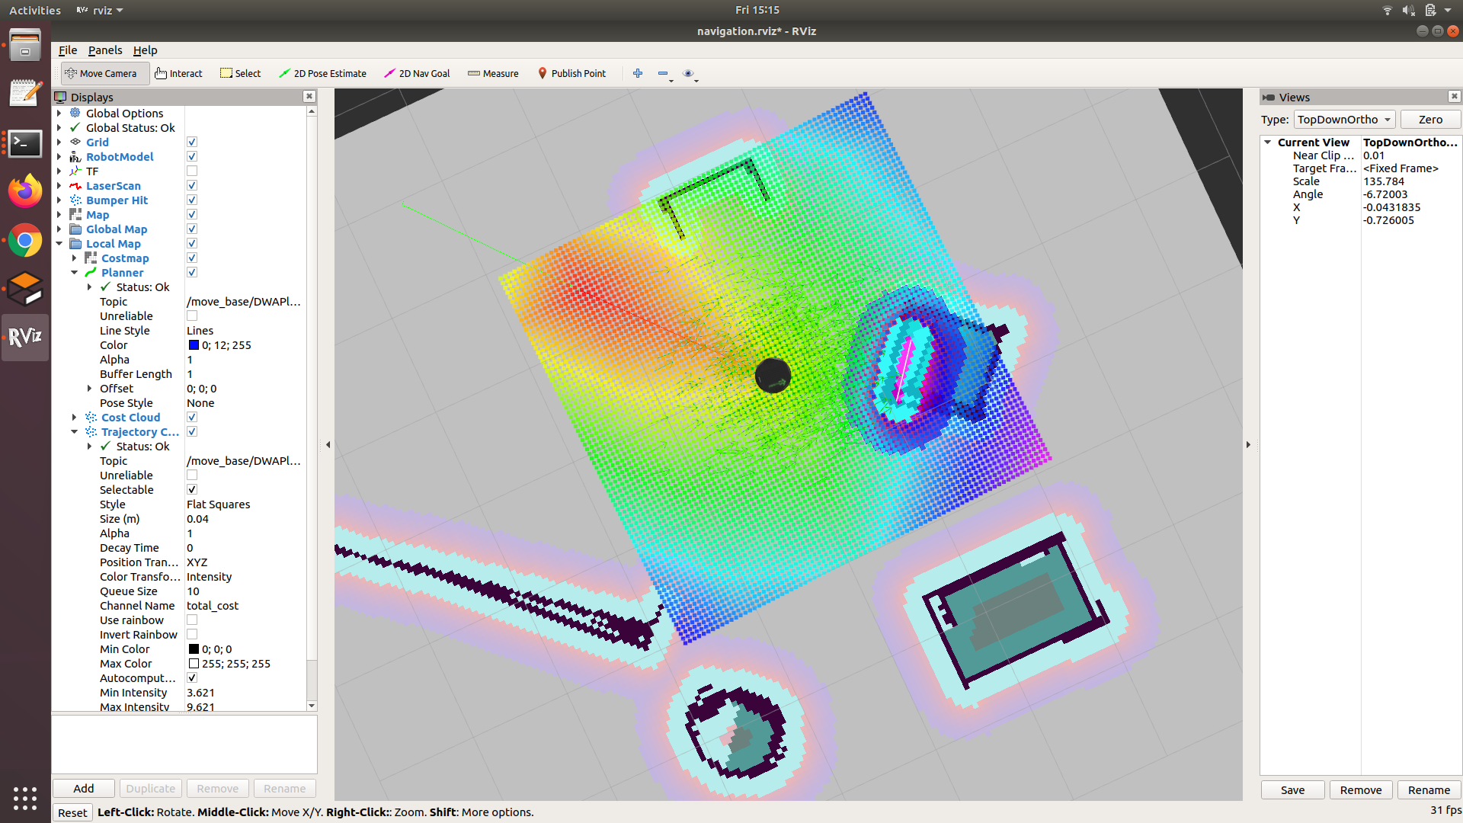
TURTLEBOT DEMO AND TUTORIAL (SIMULATION)
OBSTACLE AVOIDANCE
EXAMPLE
Once we have the map, the robot needs to be localized
STEP 2 - Localization and Navigation:
Terminal 1: Launch a Gazebo world
roslaunch turtlebot_gazebo turtlebot_world.launch
Terminal 2: Start the localization node (AMCL)
roslaunch turtlebot_gazebo amcl_demo.launch map_file:=/<path>/<filename>.yaml
Terminal 3: Open RViz to visualise the process
roslaunch turtlebot_rviz_launchers view_navigation.launch
Select 2D Navigation Goal and select a destination point on the map
The robot will plan a path towards the point avoiding any static as well as dynamic obstacles

Slide 32
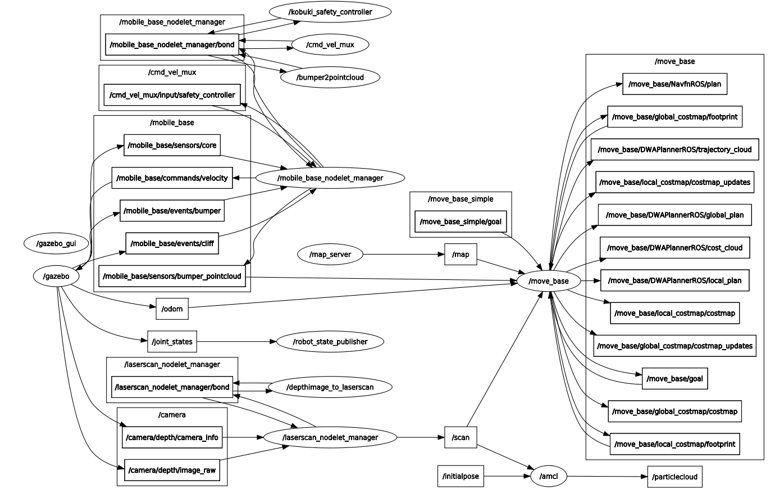
TURTLEBOT DEMO AND TUTORIAL (SIMULATION)
OBSTACLE AVOIDANCE

